Slide 1

Education Costs
Advanced Level:
Team Name: Brain Melders
Bethelhem Kassa
Beatrice Thao

Slide 2
Background
Average total cost of postsecondary institution differ (NCES)
Control of institution: Public, Private nonprofit, Private for-profit
Level of institution: Four-Year and Two-Year
Reasons for tuition increases:
1. Inflation and increased operational cost
2. Education funding cuts (center on budget and policy priorities)
Notes:
NCES: National center for education and statistics

Slide 3
Data Introduction
Analyze on 3 sets of data
National Education Cost Data, from 1986 to 2023
Public 2-year, 4-year, Private
Regional data
State data
Consumer Price Index (CPI) and conversion rate
Minnesota Educational Cost Data, from 1970 to 2019
Salary Potential Data

Slide 4
Data Summary
Convert current dollars into 2023-dollar value
No missing data except Table CP-3 (Average Published Tuition and Fees at Public Institutions by State in Current Dollars and in 2023 Dollars, 2004-05 to 2023-24) which doesn't have records for Alaska and District of Colombia (Only for public two-year): remove NA's
Notes:
Alaska and DC don’t have public 2 year

Slide 5
Data Analysis Methodologies
R for analysis
Reshape the data
One- way Anova: statistical difference
TukeyHSD: to find significant differences among means
Kmeans: to find similarities in the regional data
Paired t-test
Arima: to predict tuition

Slide 6
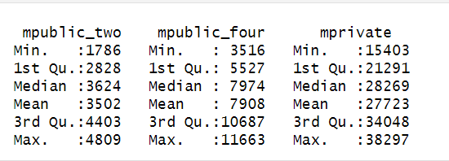
Statistical Summary of TABLE CP-1

Slide 7
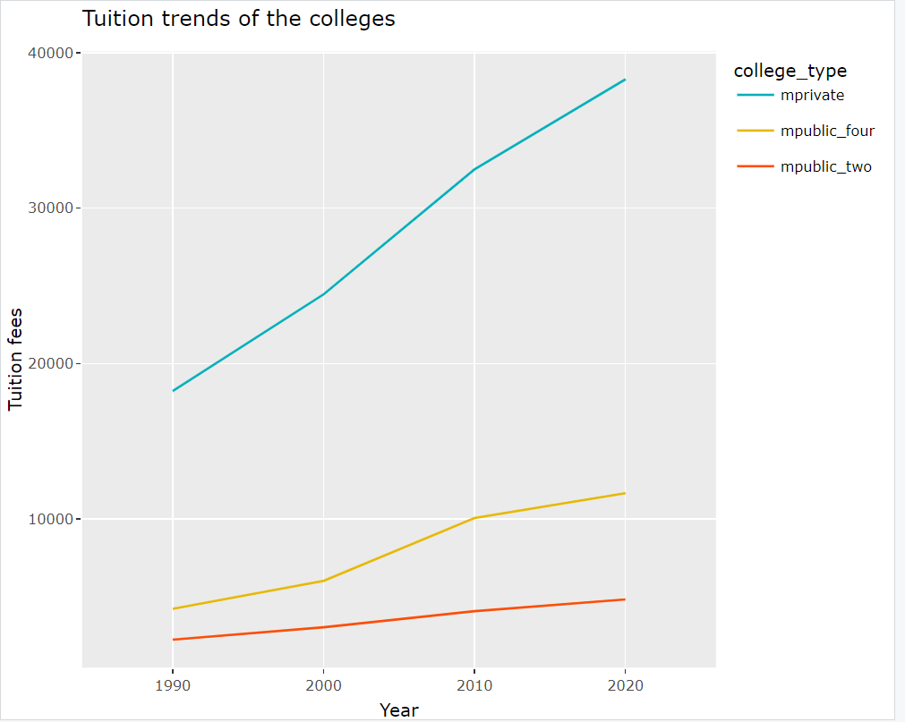
Tuition Trends
Three of them show increase
Private nonprofit Four-year:
sharp increase

Slide 8
Statistical Difference in College Tuition
Hypothesis: H0: mu(pt) = mu(pf) = mu(np); Ha: at least two average tuitions are different
Using one-way Anova(IV has three levels and 1Dv)
F = 23.09 and p-value = 0.000286
Since p-value < 0.05, reject H0, there is sufficient evidence that at least two of the average tuition fees are different
The average tuition fees between Public Four-Year & Private Nonprofit Four-Year, Public Two-Year & Private Nonprofit Four-Year are significantly different

Slide 9
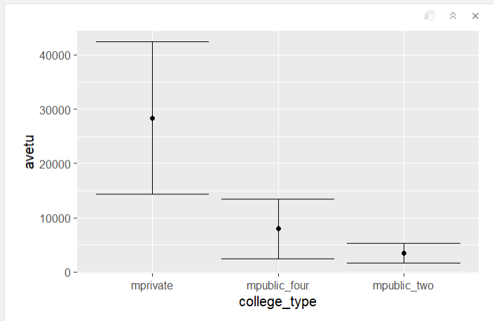
Mean Difference Between the Three Institutions

Slide 10
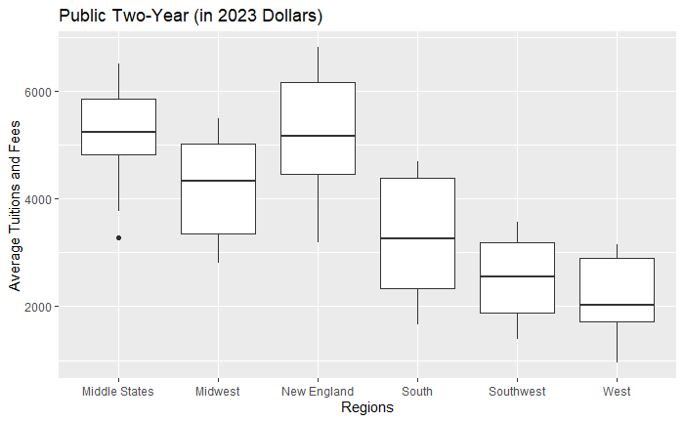
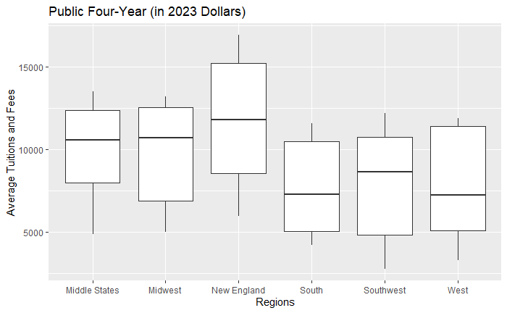
Exploratory Average Tuitions and Fees per Region (In-State)
Public Two-Year
Public Four-Year
Notes:
Disproportional spread of tuition in 2y
West 2y: low: $960 and high $3160
New England 2y low: $3,180 and high $6810
Whereas the 4y institutions, tuitions are range except for NE which is tuitions range is higher than the rest

Slide 11
Exploratory Two-Year Public Institutions per Regions

Slide 12
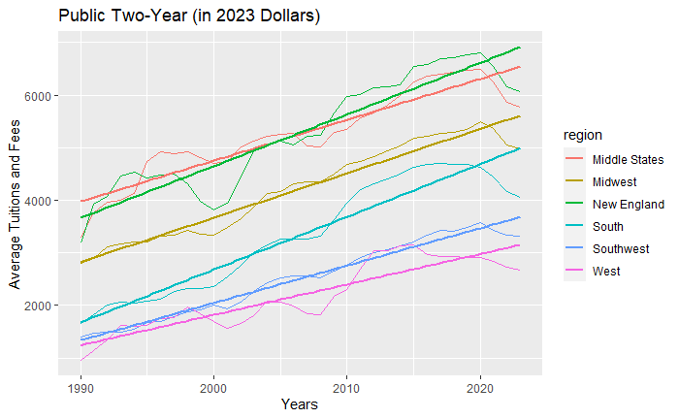
Trends and Patterns for Public Two-Year Institutes
Each region is seeing a positive increase in average tuition and fees over the years.

Slide 13
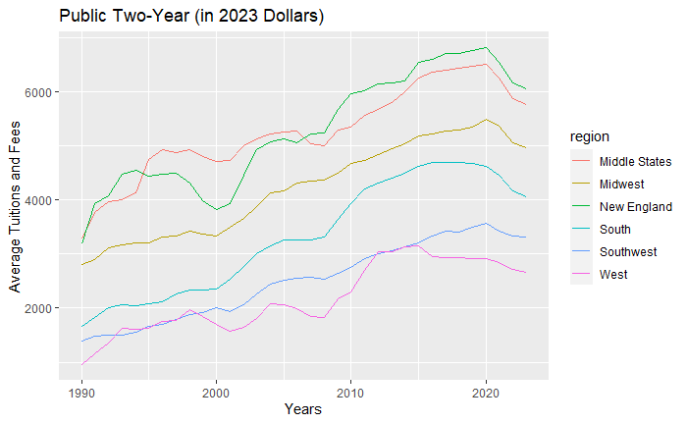
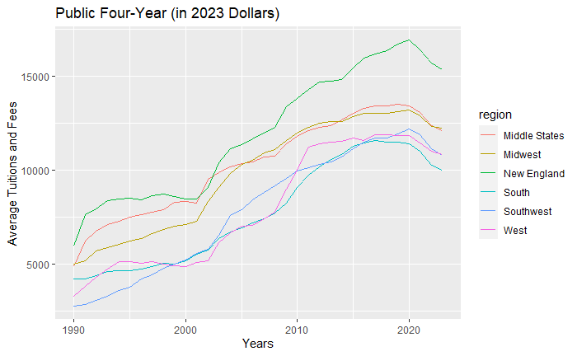
Trends and Patterns
Public Two-Year
Public Four-Year
Notes:
2 year – no surprises that

Slide 14

Statistical Difference For 2-Year Institutions
Hypothesis: The average tuition and fees are significantly different among the six regions: Middle States(1), Midwest(2), New England(3), South(6), Southwest(5), and West(6) for the two-year public institutes
H0: mu1=mu2=mu3=mu4=mu5=mu6
Ha: at least 2 mu are not equal
Using One-Way ANOVA
F = 80.03 and p-value = $2∗{10}^{−16}$
There is significant difference in the average tuition and fees among the six regions for the two-year public institutes at significant level of 0.05.

Slide 15
Statistical difference for 2-year Institutions (cont’d)
The average tuitions and fees are significant different between the regions below:
Midwest and Middle States
New England and Midwest
South and Midwest
South and Southwest
West and South
West Southwest

Slide 16
Exploratory Four-Year Public Institutions per Regions

Slide 17

Statistical Difference For 4-Year Institutions
Hypothesis: The average tuition and fees are significantly different among the six regions: Middle States(1), Midwest(2), New England(3), South(6), Southwest(5), and West(6 for the four-year public institutes
H0: mu1=mu2=mu3=mu4=mu5=mu6
Ha: at least 2 mu are not equal
Using One-Way ANOVA
F = 10.84 and p-value = $3.16∗{10}^{−9}$
There is significant difference in the average tuition and fees among the six regions for the four-year public institutes at significant level of 0.05.

Slide 18
Statistical Difference For 4-Year Institutions (cont’d)
The average tuitions and fees are significant different between the regions below:
Midwest and Middle States
New England and Midwest
South and Midwest
Southwest and South
West and South

Slide 19
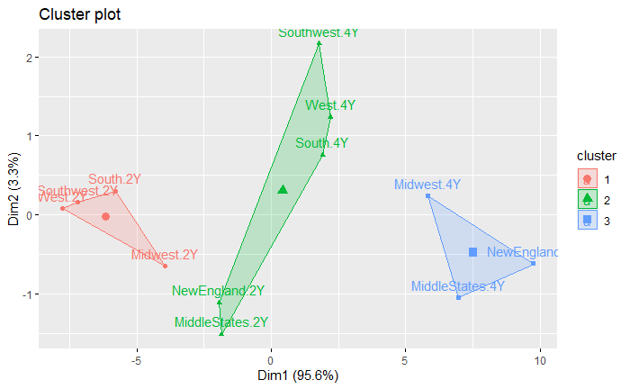
Two-Year and Four-Year Institution Comparison
2-year college in New England and Middle States are as expansive as 4-year University in the South, West, and Southwest.
2-year college West, Southwest, South, and Midwest have similar tuition increase.
Same for 4-year Midwest, Middle States and New England
Notes:
Take away: New England and Middle States that are starting their degree in a 2 year public university can

Slide 20
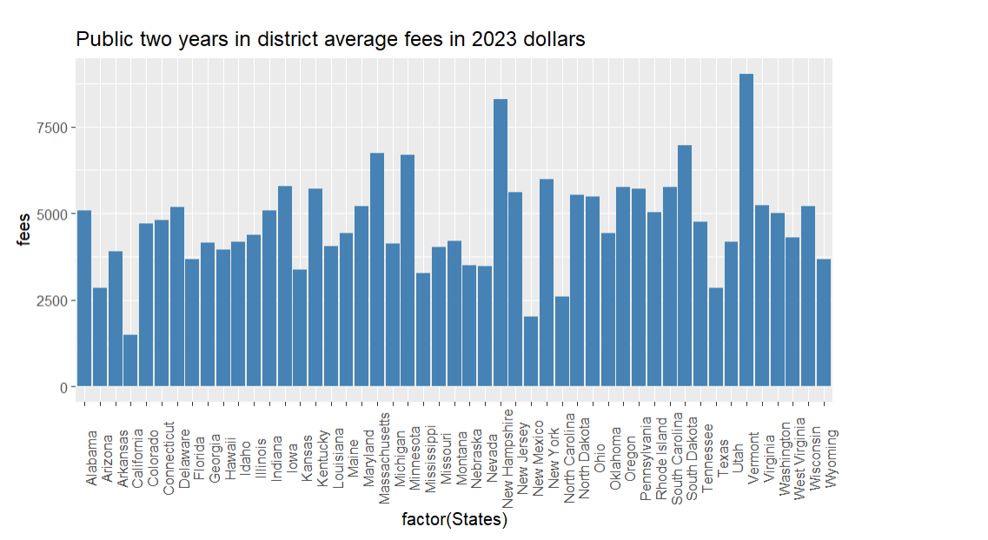
Average Tuition of Public-Two years among Different States

Slide 21
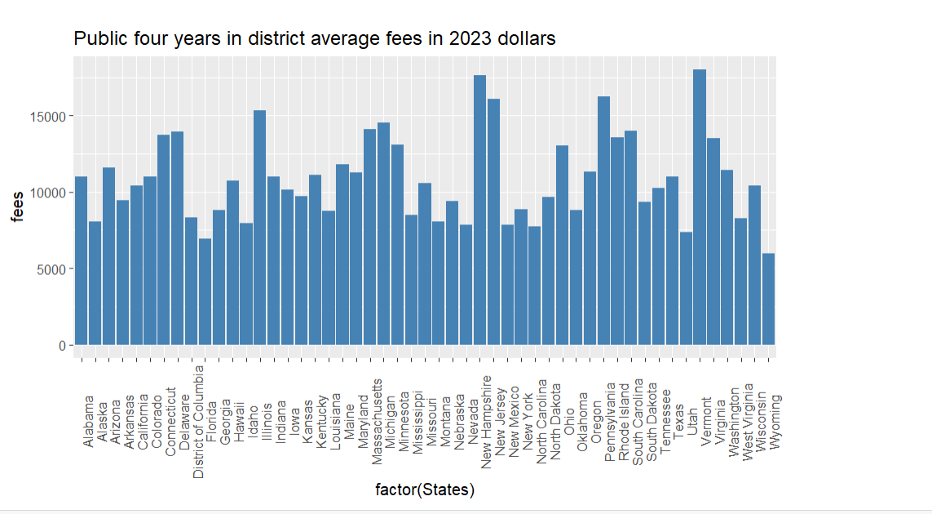
Average Tuition of Public-Four years Among Different States

Slide 22
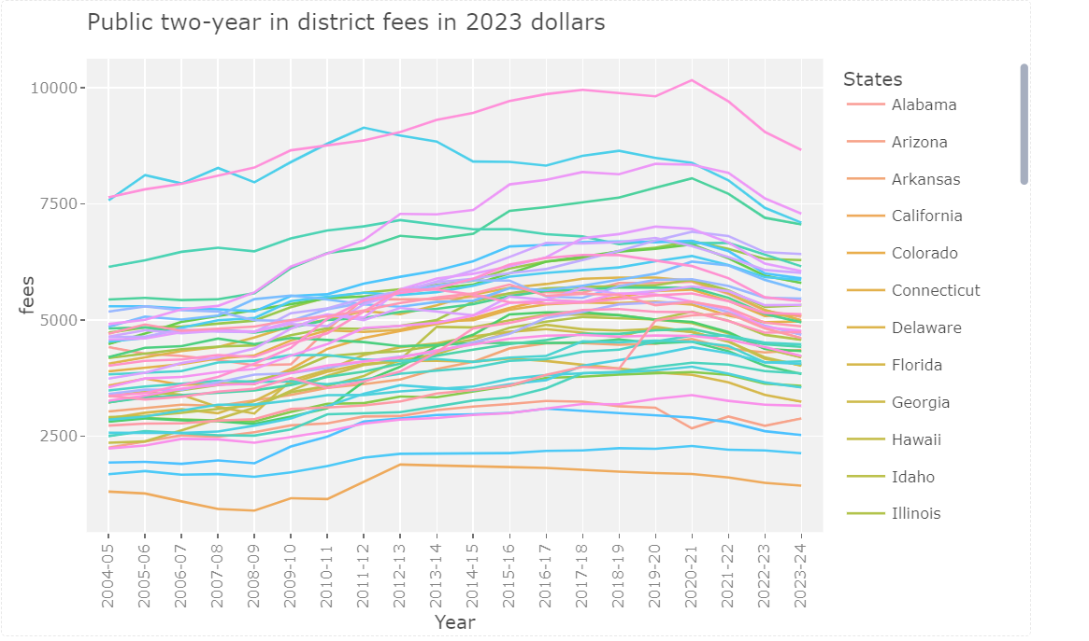
Public Two-year In District Fees (2004-05 to 2023-24)

Slide 23
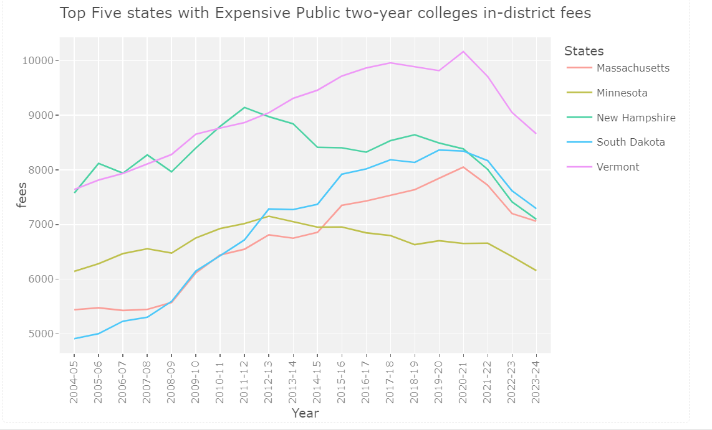
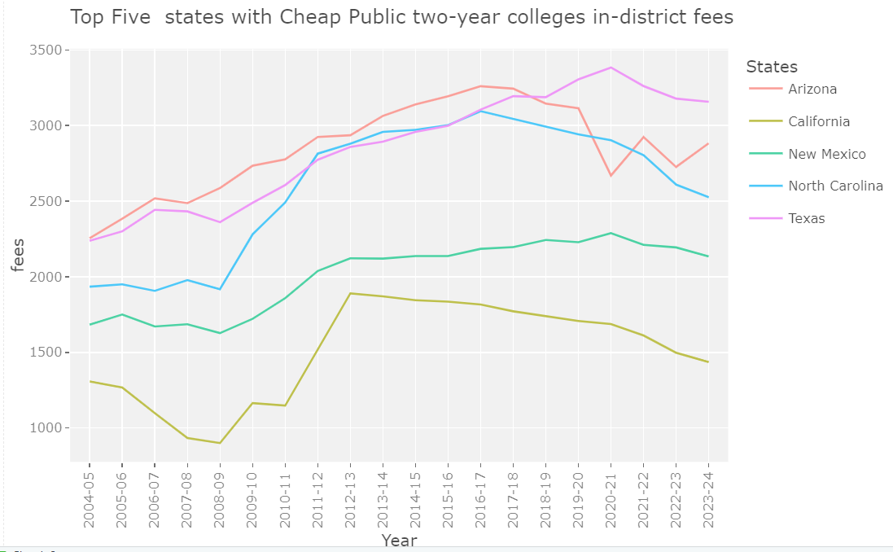
Public Two-year In District Fees (2004-05 to 2023-24)

Slide 24
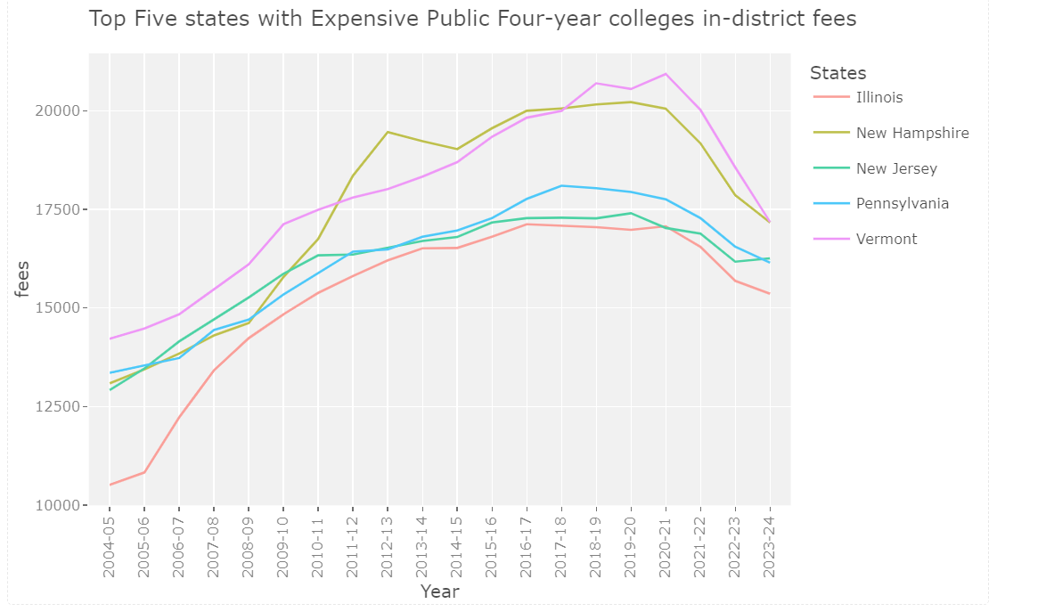
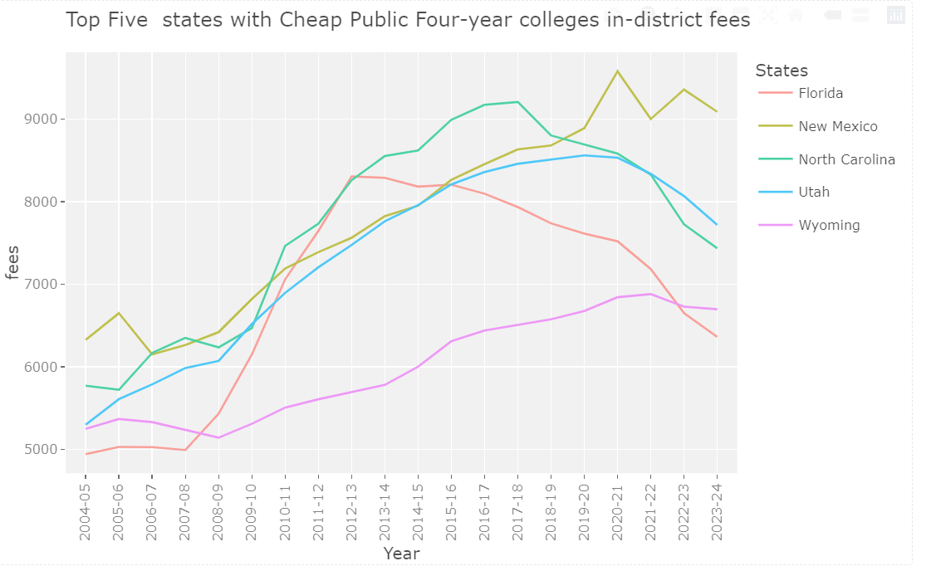
Public Four-year In District Fees (2004-05 to 2023-24)

Slide 25
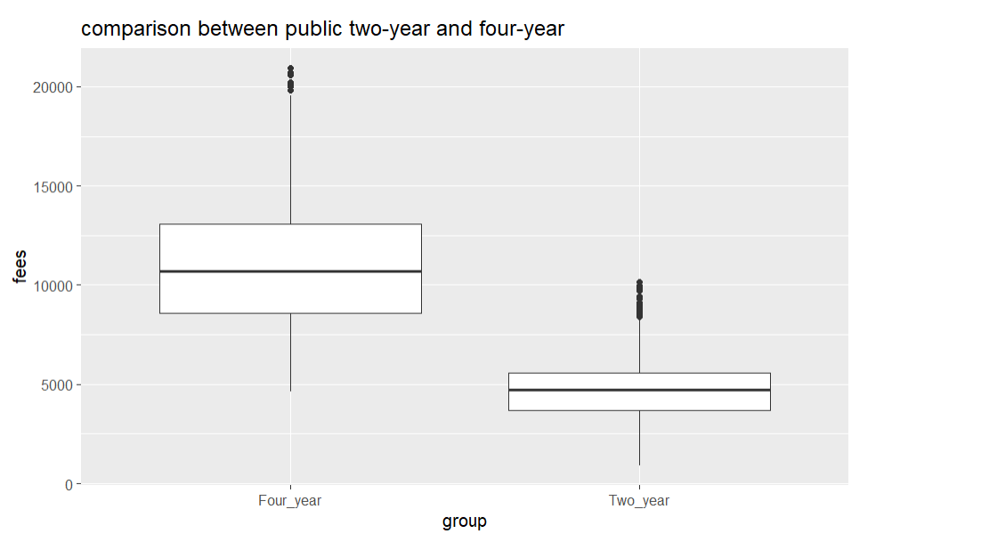
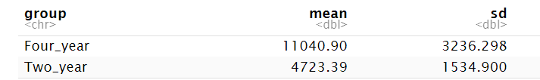
Average Tuition Fees Comparison between Public Two-year and Public Four-year Schools

Slide 26
Statistical Difference
H0: mu(two) = mu(four);Ha: mu(two) != mu(four)
Paired t-test
t = 78.982 and p-value < 0.05, reject H0
Therefore, there is evidence to support a significant difference between the average of two-year and four-year schools

Slide 27
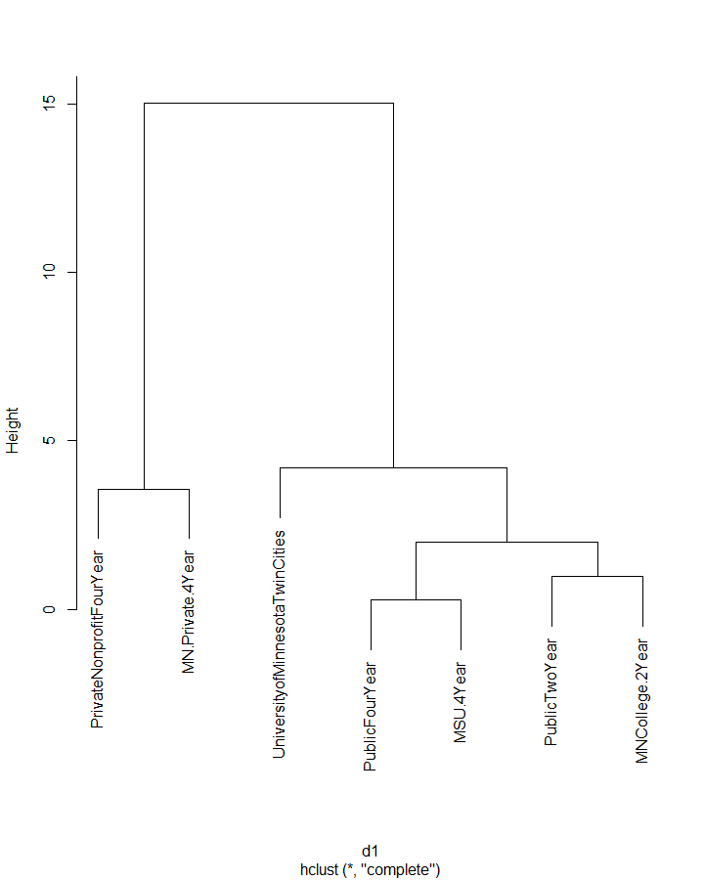
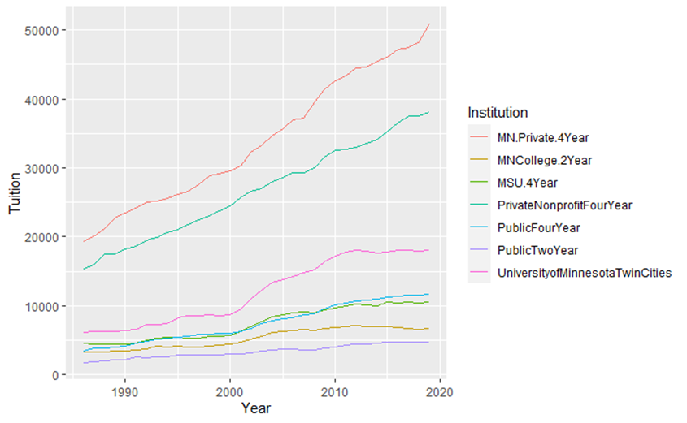
Minnesota Data – Tuition Trend

Slide 28
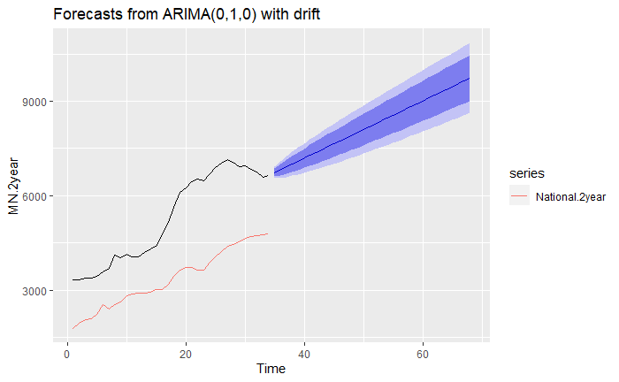
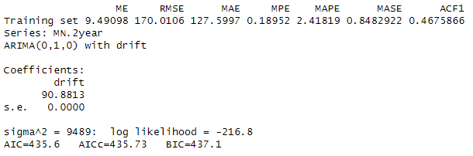

Prediction for 2020, 2021, 2022, 2023 Tuition MN College

Slide 29
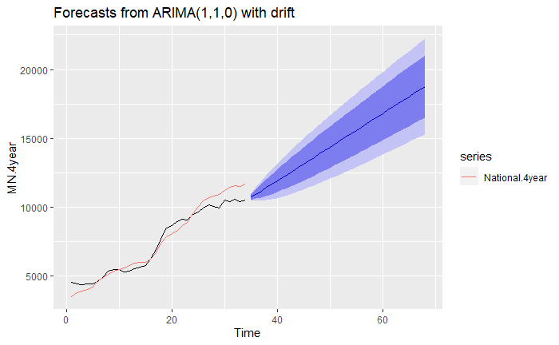
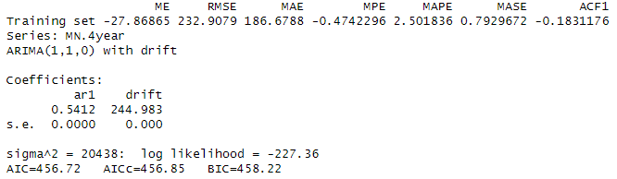

Prediction for 2020, 2021, 2022, 2023 Tuition MN University

Slide 30
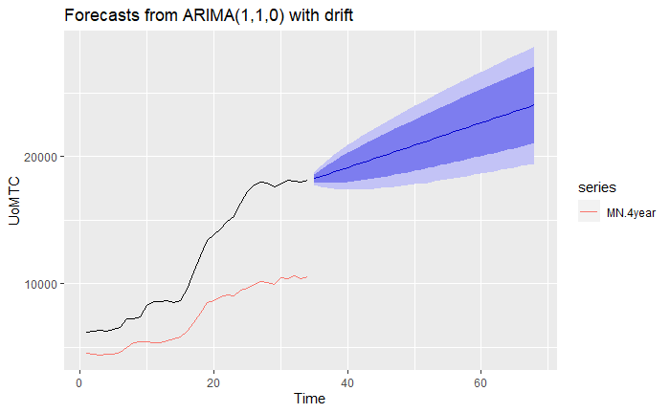
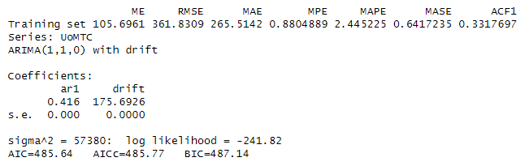

Prediction for 2020, 2021, 2022, 2023 Tuition UoM Twin Cities
Notes:
Model of UOM TC vs 2 year national, AIC is 490.71, which is greater than this model.
Root mean square error is greater

Slide 31
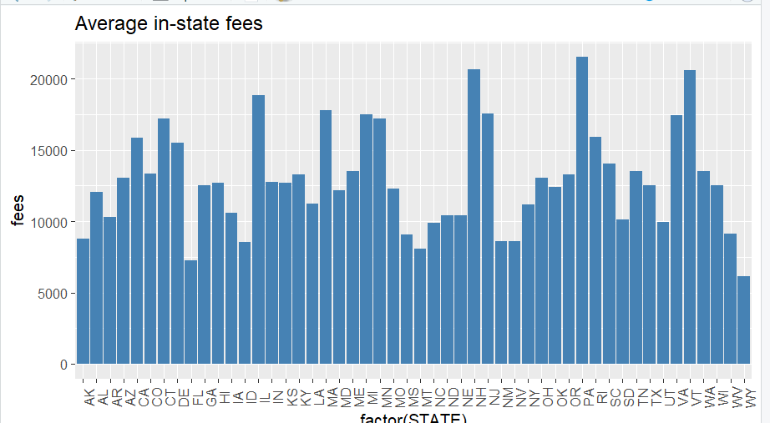
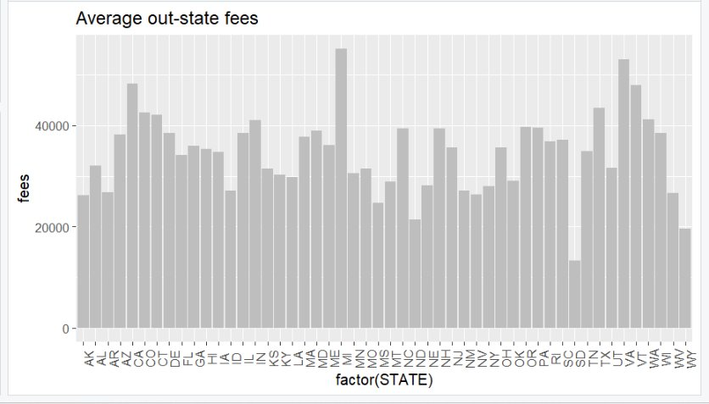
Average In-state & Out-state tuition

Slide 32
Statistical Difference Between In-state & Out-state Tuition
H0: mu(in) = mu(out); Ha: mu(in) != mu(out)
Paired t-test
t = -64.753 and p-value < 0.05, reject H0
Therefore, there is evidence to support a significant difference between the average for in-state and out-state tuition

Slide 33
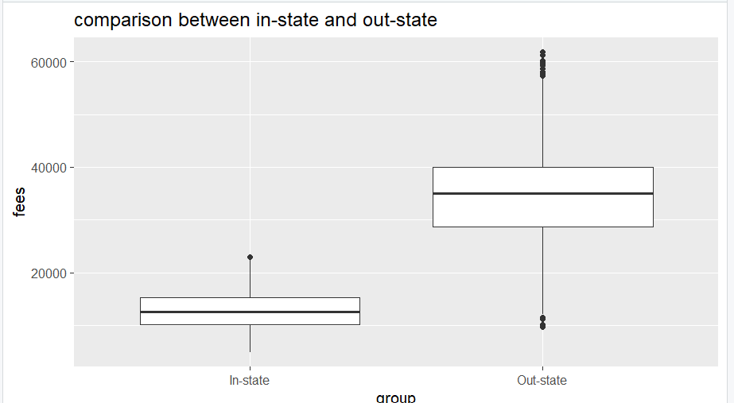
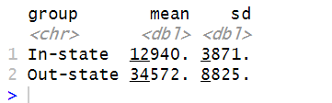
Mean Difference Between In-State & Out-State Tuitions

Slide 34
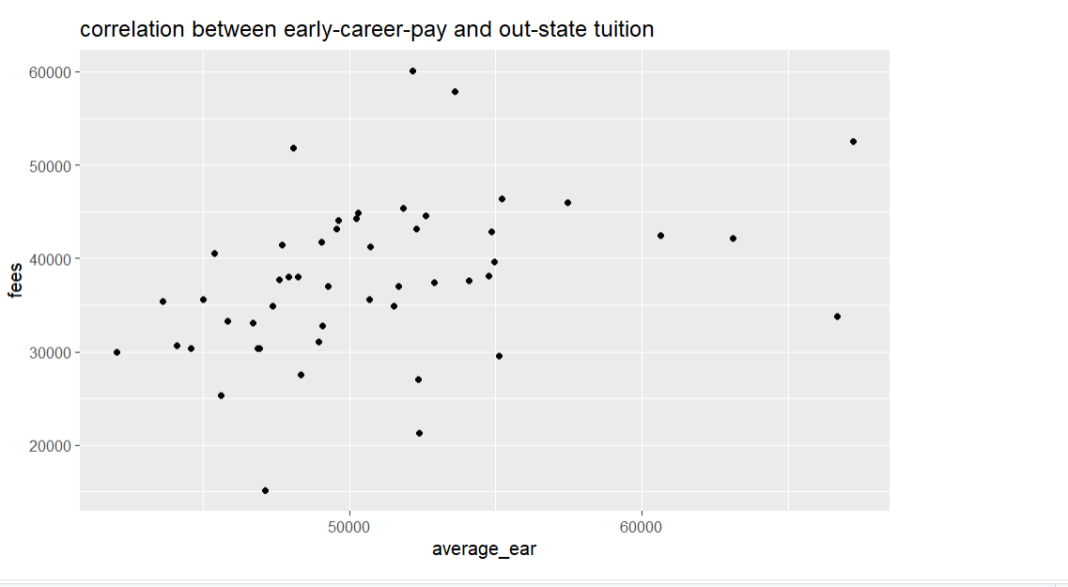
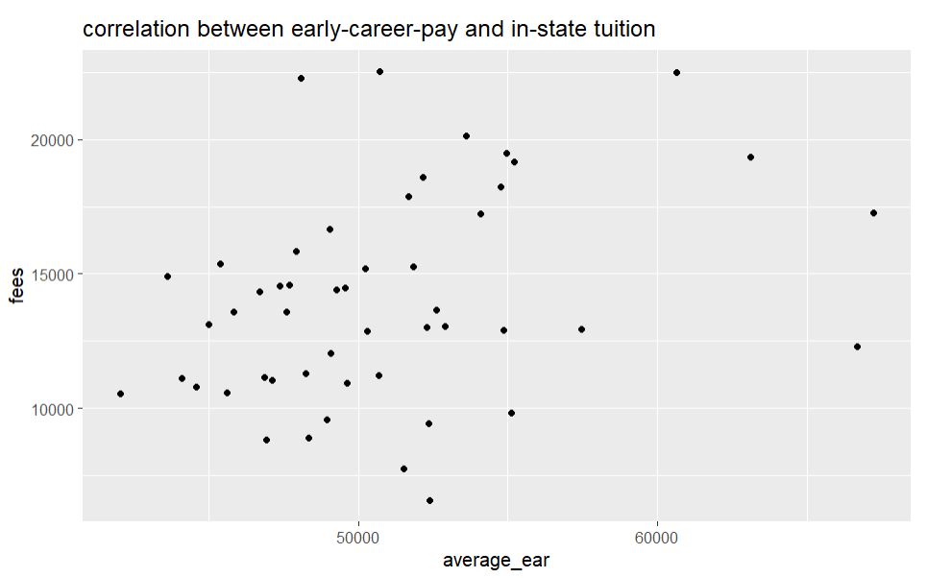
Correlation Between Early-career Pay and Average Tuition for 2018-19

Slide 35
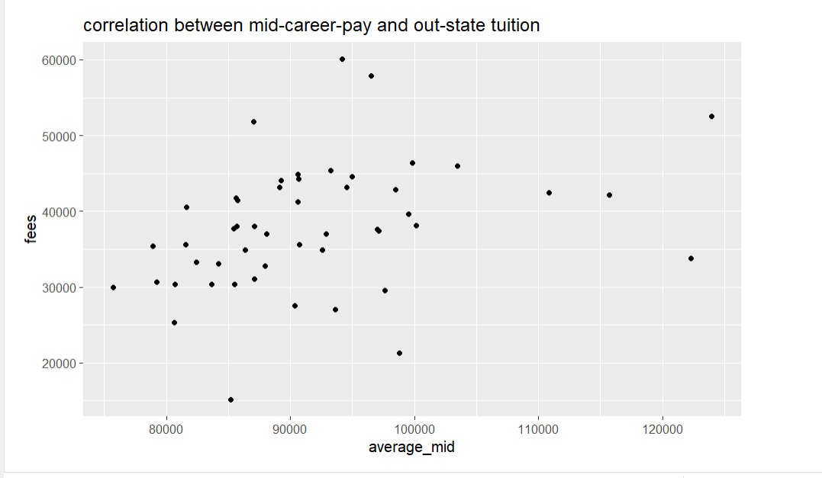
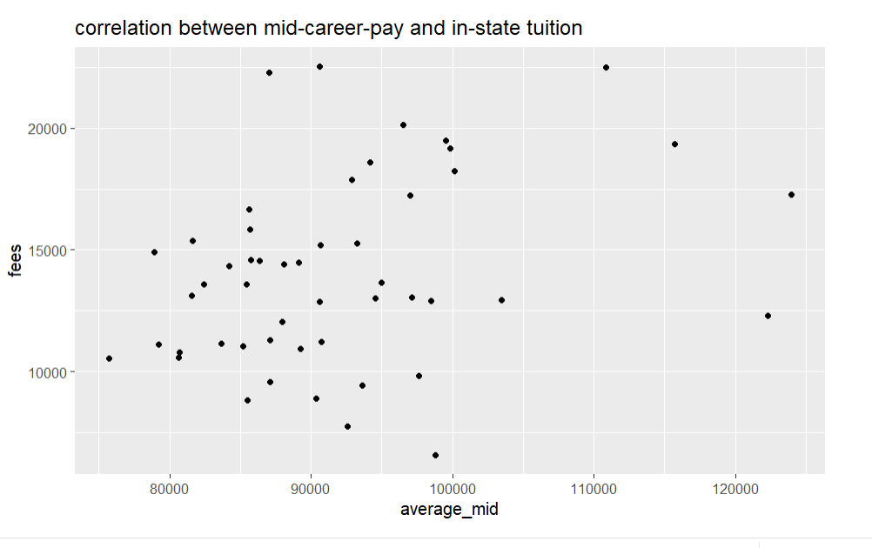
Correlation Between Mid-career Pay and Average Tuition for 2018-19

Slide 36
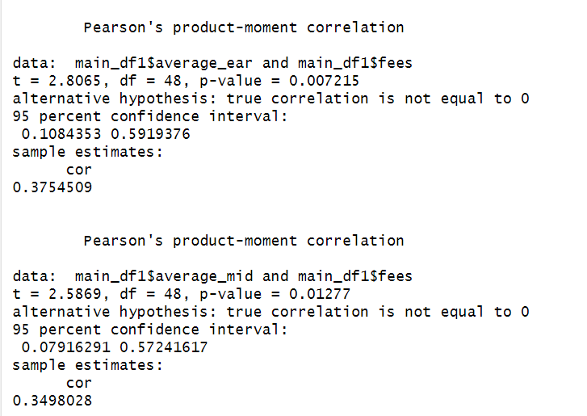
Correlation Between Out-state Tuition and Salary Pay
Weak positive correlation

Slide 37
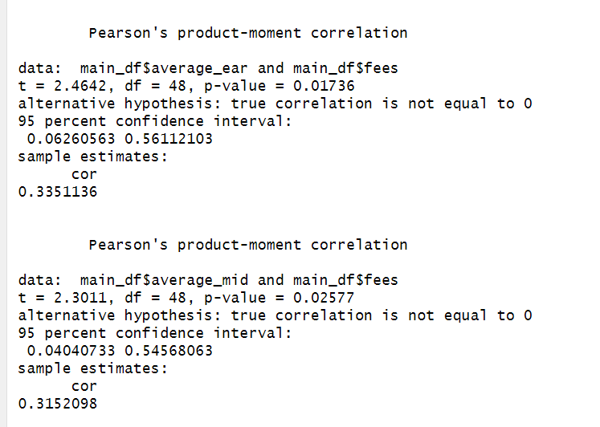
Correlation Between In-state Tuition and Salary Pay
Weak positive correlation

